Slide 1
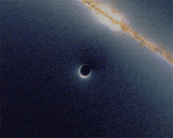
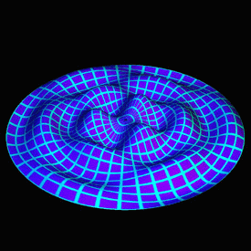
Graphs: Geometry, Operators, Spectra, and Kernels
Mike Slawinski
July 14, 2017

Slide 2
Graph Theory – Applications to Cylance Data
Graph Structured Data

Slide 3
Graph Theory – Applications to Cylance Data
Graph Structured Data
one-hot encoded vectors (nodes in a hypercube, which is itself a graph)

Slide 4
Graph Theory – Applications to Cylance Data
Graph Structured Data
one-hot encoded vectors (nodes in a hypercube, which is itself a graph)
optics process/network data

Slide 5
Graph Theory – Applications to Cylance Data
Graph Structured Data
one-hot encoded vectors (nodes in a hypercube, which is itself a graph)
optics process/network data
identity process/network data

Slide 6
Graph Theory – Applications to Cylance Data
Graph Structured Data
one-hot encoded vectors (nodes in a hypercube, which is itself a graph)
optics process/network data
identity process/network data
graphs arising from decompilation (control flow, function to function, etc.)

Slide 7
Graph Theory – Applications to Cylance Data
Graph Structured Data
one-hot encoded vectors (nodes in a hypercube, which is itself a graph)
optics process/network data
identity process/network data
graphs arising from decompilation (control flow, function to function, etc.)
What would we like to be able to do with this data?

Slide 8
Graph Theory – Applications to Cylance Data
Graph Structured Data
one-hot encoded vectors (nodes in a hypercube, which is itself a graph)
optics process/network data
identity process/network data
graphs arising from decompilation (control flow, function to function, etc.)
What would we like to be able to do with this data?
compare nodes within a graph
clustering in hypercube space

Slide 9
Graph Theory – Applications to Cylance Data
Graph Structured Data
one-hot encoded vectors (nodes in a hypercube, which is itself a graph)
optics process/network data
identity process/network data
graphs arising from decompilation (control flow, function to function, etc.)
What would we like to be able to do with this data?
compare nodes within a graph
clustering in hypercube space
compare processes/network events in a Markov model

Slide 10
Graph Theory – Applications to Cylance Data
Graph Structured Data
one-hot encoded vectors (nodes in a hypercube, which is itself a graph)
optics process/network data
identity process/network data
graphs arising from decompilation (control flow, function to function, etc.)
What would we like to be able to do with this data?
compare nodes within a graph
clustering in hypercube space
compare processes/network events in a Markov model
compare graphs to each other – compare files via control flow comparison

Slide 11
Graph Theory – Applications to Cylance Data
Graph Structured Data
one-hot encoded vectors (nodes in a hypercube, which is itself a graph)
optics process/network data
identity process/network data
graphs arising from decompilation (control flow, function to function, etc.)
What would we like to be able to do with this data?
compare nodes within a graph
clustering in hypercube space
compare processes/network events in a Markov model
compare graphs to each other – compare files via control flow comparison
Solution: Graph Kernels (measure node similarity and graph similarity)

Slide 12
Kernels and Vectorization
Definition: A kernel $K$ on a space $Ω$ is a function $K:Ω×Ω→ℝ$, which is meant to measure the similarity
between elements $x,x^{′}∈Ω.$

Slide 13
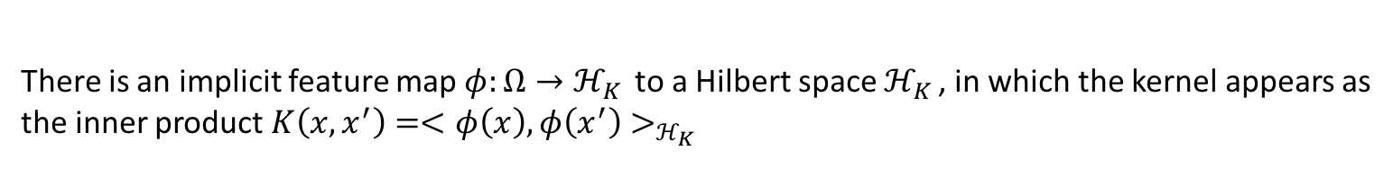
Kernels and Vectorization
Definition: A kernel $K$ on a space $Ω$ is a function $K:Ω×Ω→ℝ$, which is meant to measure the similarity
between elements $x,x^{′}∈Ω.$
There is an implicit feature map $φ:Ω→ℋ_{K }$to a Hilbert space $ℋ_{K }$, in which the kernel appears as
the inner product $K\left(x,x^{′}\right)=<φ\left(x\right),φ\left(x^{′}\right)>_{ℋ_{K }}$

Slide 14
Kernels and Vectorization
Definition: A kernel $K$ on a space $Ω$ is a function $K:Ω×Ω→ℝ$, which is meant to measure the similarity
between elements $x,x^{′}∈Ω.$
There is an implicit feature map $φ:Ω→ℋ_{K }$to a Hilbert space $ℋ_{K }$, in which the kernel appears as
the inner product $K\left(x,x^{′}\right)=<φ\left(x\right),φ\left(x^{′}\right)>_{ℋ_{K }}$
A Hilbert space $H_{K}$ is a real or complex inner product space that is also a complete metric space
with respect to the distance function induced by the inner product.

Slide 15
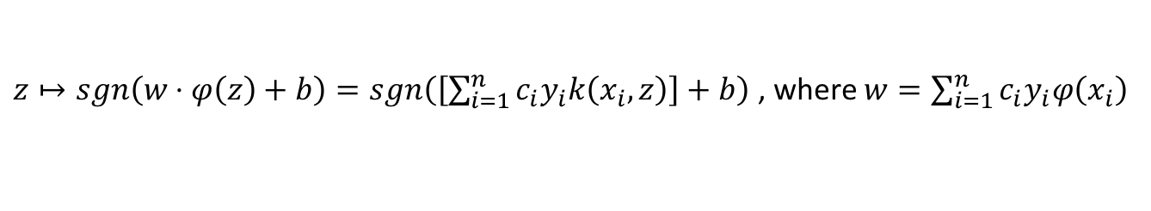
Kernels and Vectorization
Definition: A kernel $K$ on a space $Ω$ is a function $K:Ω×Ω→ℝ$, which is meant to measure the similarity
between elements $x,x^{′}∈Ω.$
There is an implicit feature map $φ:Ω→ℋ_{K }$to a Hilbert space $ℋ_{K }$, in which the kernel appears as
the inner product $K\left(x,x^{′}\right)=<φ\left(x\right),φ\left(x^{′}\right)>_{ℋ_{K }}$
A Hilbert space $H_{K}$ is a real or complex inner product space that is also a complete metric space
with respect to the distance function induced by the inner product.
Kernel Trick:
Example: SVM Classifier
$z↦sgn\left(w⋅φ\left(z\right)+b\right)=sgn\left(\left[\sum_{i=1}^{n}{c_{i}y_{i}k\left(x_{i},z\right)}\right]+b\right)$ , where $w=\sum_{i=1}^{n}{c_{i}y_{i}φ\left(x_{i}\right)}$
Idea is to compute similarity without actually mapping to a higher dimensional space.

Slide 16
Graph Kernels
Two Types:
Type I: Measure similarity between nodes based on edge structure of the graph

Slide 17
Graph Kernels
Two Types:
Type I: Measure similarity between nodes based on edge structure of the graph
Type II: Measure similarity between graphs based on edge structure,
labeling, etc.

Slide 18
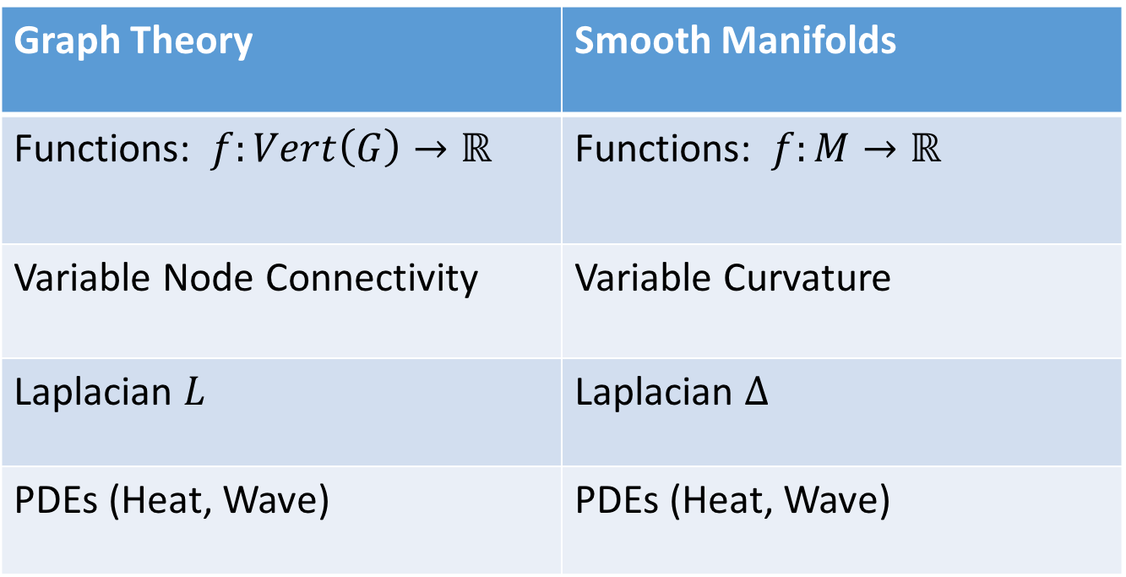
Kernel Development: Graph Theoretic Analogues to Smooth Manifolds
Graph Theory | Smooth Manifolds
Functions: $f:Vert\left(G\right)→ℝ$ | Functions: $f:M→ℝ$
Variable Node Connectivity | Variable Curvature
Laplacian $L$ | Laplacian $Δ$
PDEs (Heat, Wave) | PDEs (Heat, Wave)

Slide 19

Curvature – Comparing $f$ to its Average
The curvature $κ$of a curve given by $y=f\left(x\right)$ is given by $κ= \frac{|y^{′′}|}{{\left(1+y^{′2}\right)}^{\frac{3}{2}}}$

Slide 20
Curvature – Comparing $f$ to its Average
The curvature $κ$of a curve given by $y=f\left(x\right)$ is given by $κ= \frac{|y^{′′}|}{{\left(1+y^{′2}\right)}^{\frac{3}{2}}}$
The Laplacian operator $Δf≔\frac{∂^{2}}{∂x^{2}}f$ serves as a proxy for curvature when $\left|\frac{∂}{∂x}f −1\right|<ε$

Slide 21
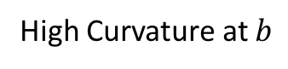
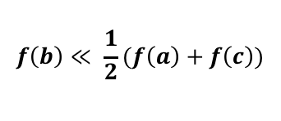
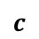
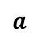
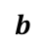
Curvature – Comparing $f$ to its Average
The curvature $κ$of a curve given by $y=f\left(x\right)$ is given by $κ= \frac{|y^{′′}|}{{\left(1+y^{′2}\right)}^{\frac{3}{2}}}$
The Laplacian operator $Δf≔\frac{∂^{2}}{∂x^{2}}f$ serves as a proxy for curvature when $\left|\frac{∂}{∂x}f −1\right|<ε$
High Curvature at $b$
$$a$$
$$b$$
$$c$$
$$f\left(b\right)≪ \frac{1}{2}(f\left(a\right)+f\left(c\right))$$

Slide 22
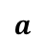
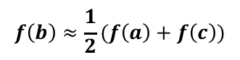
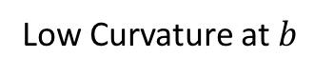
Curvature – Comparing $f$ to its Average
The curvature $κ$of a curve given by $y=f\left(x\right)$ is given by $κ= \frac{|y^{′′}|}{{\left(1+y^{′2}\right)}^{\frac{3}{2}}}$
The Laplacian operator $Δf≔\frac{∂^{2}}{∂x^{2}}f$ serves as a proxy for curvature when $\left|\frac{∂}{∂x}f −1\right|<ε$
High Curvature at $b$
Low Curvature at $b$
$$a$$
$$b$$
$$c$$
$$a$$
$$b$$
$$c$$
$$f\left(b\right)≪ \frac{1}{2}(f\left(a\right)+f\left(c\right))$$
$$f\left(b\right)≈\frac{1}{2}(f\left(a\right)+f\left(c\right))$$

Slide 23
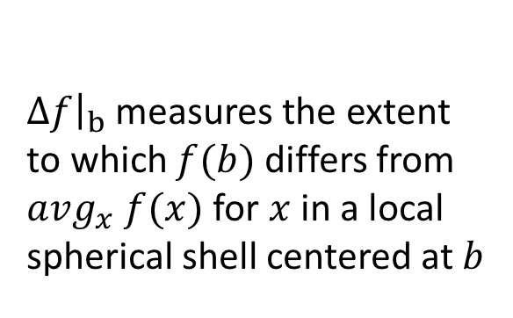
Curvature – Comparing $f$ to its Average
The curvature $κ$of a curve given by $y=f\left(x\right)$ is given by $κ= \frac{|y^{′′}|}{{\left(1+y^{′2}\right)}^{\frac{3}{2}}}$
The Laplacian operator $Δf≔\frac{∂^{2}}{∂x^{2}}f$ serves as a proxy for curvature when $\left|\frac{∂}{∂x}f −1\right|<ε$
High Curvature at $b$
Low Curvature at $b$
Key Point
$Δf{\left.​\right|}_{b}$ measures the extent
to which $f(b)$ differs from
$avg_{x} f(x)$for $x$ in a local
spherical shell centered at $b$
$$a$$
$$b$$
$$c$$
$$a$$
$$b$$
$$c$$
$$f\left(b\right)≪ \frac{1}{2}(f\left(a\right)+f\left(c\right))$$
$$f\left(b\right)≈\frac{1}{2}(f\left(a\right)+f\left(c\right))$$

Slide 24
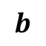
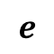
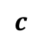
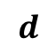
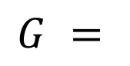
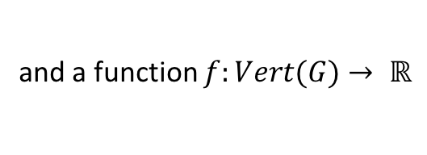
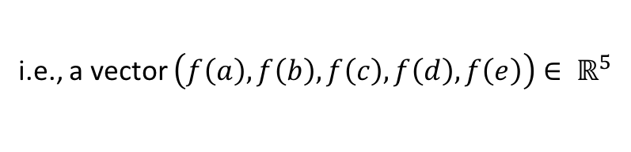

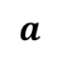
Curvature – Comparing $f$ to its Average (Discrete Version)
Consider the graph
$$G =$$
$$a$$
$$b$$
$$c$$
$$d$$
$$e$$
and a function $f:Vert(G)$ $→ ℝ$
i.e., a vector $\left(f\left(a\right), f\left(b\right), f\left(c\right), f\left(d\right), f\left(e\right)\right)∈ ℝ^{5}$

Slide 25
Curvature – Comparing $f$ to its Average (Discrete Version)
Consider the graph
$$G =$$
$$a$$
$$b$$
$$c$$
$$d$$
$$e$$
and a function $f:Vert(G)$ $→ ℝ$
i.e., a vector $\left(f\left(a\right), f\left(b\right), f\left(c\right), f\left(d\right), f\left(e\right)\right)∈ ℝ^{5}$
Question: How can we define notions of the second derivative and the Laplacian operator on G?

Slide 26
Curvature – Comparing $f$ to its Average (Discrete Version)
Consider the graph
$$G =$$
$$a$$
$$b$$
$$c$$
$$d$$
$$e$$
and a function $f:Vert(G)$ $→ ℝ$
i.e., a vector $\left(f\left(a\right), f\left(b\right), f\left(c\right), f\left(d\right), f\left(e\right)\right)∈ ℝ^{5}$
Question: How can we define notions of the second derivative and the Laplacian operator on G?
Answer: Think of G as a discrete version of the real line and compute a difference quotient of difference quotients.

Slide 27
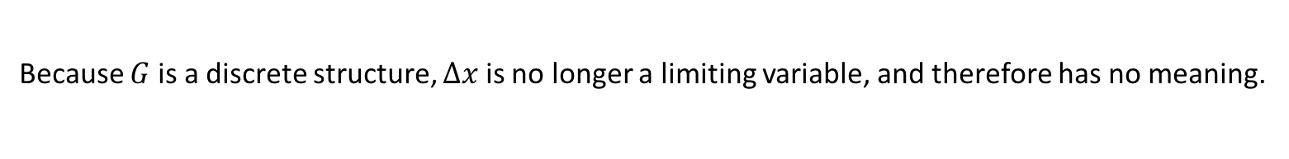
Curvature – Comparing $f$ to its Average (Discrete Version)
Consider the graph
$$G =$$
$$a$$
$$b$$
$$c$$
$$d$$
$$e$$
and a function $f:Vert(G)$ $→ ℝ$
i.e., a vector $\left(f\left(a\right), f\left(b\right), f\left(c\right), f\left(d\right), f\left(e\right)\right)∈ ℝ^{5}$
Question: How can we define notions of the second derivative and the Laplacian operator on G?
Answer: Think of G as a discrete version of the real line and compute a difference quotient of difference quotients.
$$f^{′′}\left(x\right)≈ \frac{\frac{f\left(x+Δx\right)−f(x)}{Δx}−\frac{f\left(x\right)−f(x−Δx)}{Δx}}{Δx} ≈\frac{f\left(x+Δx\right)−2f\left(x\right)+f(x−Δx)}{{\left(Δx\right)}^{2}}$$
Because $G$ is a discrete structure, $Δx$is no longer a limiting variable, and therefore has no meaning.

Slide 28
Curvature – Comparing $f$ to its Average (Discrete Version)
Consider the graph
$$G =$$
$$a$$
$$b$$
$$c$$
$$d$$
$$e$$
and a function $f:Vert(G)$ $→ ℝ$
i.e., a vector $\left(f\left(a\right), f\left(b\right), f\left(c\right), f\left(d\right), f\left(e\right)\right)∈ ℝ^{5}$
Question: How can we define notions of the second derivative and the Laplacian operator on G?
Answer: Think of G as a discrete version of the real line and compute a difference quotient of difference quotients.
$$f^{′′}\left(x\right)≈ \frac{\frac{f\left(x+Δx\right)−f(x)}{Δx}−\frac{f\left(x\right)−f(x−Δx)}{Δx}}{Δx} ≈\frac{f\left(x+Δx\right)−2f\left(x\right)+f(x−Δx)}{{\left(Δx\right)}^{2}}$$
Because $G$ is a discrete structure, $Δx$is no longer a limiting variable, and therefore has no meaning.
This yields $Δf{\left.​\right|}_{c}=\frac{∂^{2}}{∂x^{2}}f{\left.​\right|}_{c}$ $=f\left(b\right)−2f\left(c\right)+f\left(d\right),$ which measures the difference between $f(c)$and $avg\left(f\left(b\right),f\left(d\right)\right)$

Slide 29
Curvature – Higher Dimensions

Slide 30
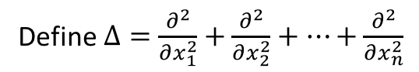
Curvature – Higher Dimensions
The Laplacian
Define $Δ=\frac{∂^{2}}{∂x_{1}^{2}}+\frac{∂^{2}}{∂x_{2}^{2}}+⋯+\frac{∂^{2}}{∂x_{n}^{2}}$

Slide 31
Curvature – Higher Dimensions
The Laplacian
Define $Δ=\frac{∂^{2}}{∂x_{1}^{2}}+\frac{∂^{2}}{∂x_{2}^{2}}+⋯+\frac{∂^{2}}{∂x_{n}^{2}}$
Application: The Wave Equation

Slide 32
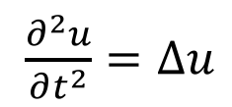
Curvature – Higher Dimensions
The Laplacian
Define $Δ=\frac{∂^{2}}{∂x_{1}^{2}}+\frac{∂^{2}}{∂x_{2}^{2}}+⋯+\frac{∂^{2}}{∂x_{n}^{2}}$
Application: The Wave Equation
$\frac{∂^{2}u}{∂t^{2}}=Δu$

Slide 33
Curvature – Higher Dimensions
The Laplacian
Define $Δ=\frac{∂^{2}}{∂x_{1}^{2}}+\frac{∂^{2}}{∂x_{2}^{2}}+⋯+\frac{∂^{2}}{∂x_{n}^{2}}$
Application: The Wave Equation
$\frac{∂^{2}u}{∂t^{2}}=Δu$
Question 1: What do the solutions to this PDE look like?

Slide 34
Curvature – Higher Dimensions
The Laplacian
Define $Δ=\frac{∂^{2}}{∂x_{1}^{2}}+\frac{∂^{2}}{∂x_{2}^{2}}+⋯+\frac{∂^{2}}{∂x_{n}^{2}}$
Application: The Wave Equation
$\frac{∂^{2}u}{∂t^{2}}=Δu$
Question 1: What do the solutions to this PDE look like?
Question 2: Is it possible to infer manifold structure from the structure of the operator?

Slide 35
Curvature – Higher Dimensions
The Laplacian
Define $Δ=\frac{∂^{2}}{∂x_{1}^{2}}+\frac{∂^{2}}{∂x_{2}^{2}}+⋯+\frac{∂^{2}}{∂x_{n}^{2}}$
Application: The Wave Equation
$\frac{∂^{2}u}{∂t^{2}}=Δu$
Question 1: What do the solutions to this PDE look like?
Question 2: Is it possible to infer manifold structure from the structure of the operator?
Question 3: Is it possible to answer Question 2 in the graph case?

Slide 36
The Laplacian and the Wave Equation
Intuitively, what constraints should a wave-like function $u(x,t)$ satisfy?

Slide 37
The Laplacian and the Wave Equation
Intuitively, what constraints should a wave-like function $u(x,t)$ satisfy?
Points which are associated with high curvature should
more quickly straighten.

Slide 38
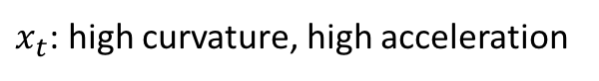
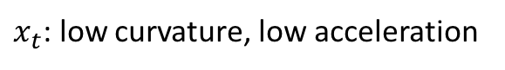
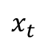
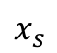
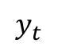
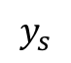
The Laplacian and the Wave Equation
Intuitively, what constraints should a wave-like function $u(x,t)$ satisfy?
$$x_{t}$$
Points which are associated with high curvature should
more quickly straighten.
$$y_{t}$$
$$x_{s}$$
$$y_{s}$$
$x_{t}$: high curvature, high acceleration
$x_{t}$: low curvature, low acceleration

Slide 39
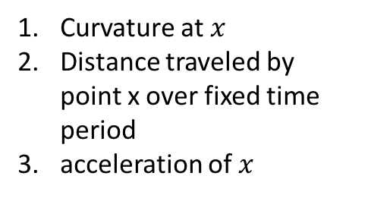
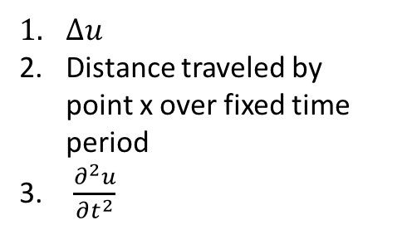
The Laplacian and the Wave Equation
Intuitively, what constraints should a wave-like function $u(x,t)$ satisfy?
$$x_{t}$$
Points which are associated with high curvature should
more quickly straighten.
$$y_{t}$$
$$x_{s}$$
Curvature at $x$
Distance traveled by point x over fixed time period
acceleration of $x$
$Δu$
Distance traveled by point x over fixed time period
$\frac{∂^{2}u}{∂t^{2}}$
$$y_{s}$$
$x_{t}$: high curvature, high acceleration
$x_{t}$: low curvature, low acceleration

Slide 40
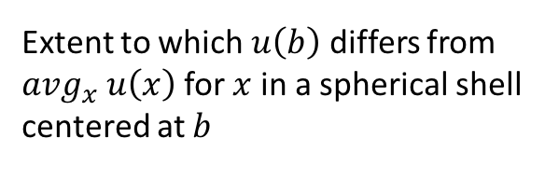
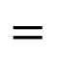
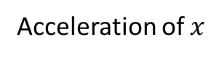
The Laplacian and the Wave Equation
Intuitively, what constraints should a wave-like function $u(x,t)$ satisfy?
$$x_{t}$$
Points which are associated with high curvature should
more quickly straighten.
$$y_{t}$$
$$x_{s}$$
Curvature at $x$
Distance traveled by point x over fixed time period
acceleration of $x$
$Δu$
Distance traveled by point x over fixed time period
$\frac{∂^{2}u}{∂t^{2}}$
$$y_{s}$$
Extent to which $u\left(b\right)$ differs from
$avg_{x} u\left(x\right)$for $x$ in a spherical shell
centered at $b$
$$=$$
Acceleration of $x$
$x_{t}$: high curvature, high acceleration
$x_{t}$: low curvature, low acceleration

Slide 41
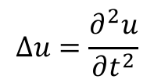
The Laplacian and the Wave Equation
Intuitively, what constraints should a wave-like function $u(x,t)$ satisfy?
$$x_{t}$$
Points which are associated with high curvature should
more quickly straighten.
$$y_{t}$$
$$x_{s}$$
Curvature at $x$
Distance traveled by point x over fixed time period
acceleration of $x$
$Δu$
Distance traveled by point x over fixed time period
$\frac{∂^{2}u}{∂t^{2}}$
$$y_{s}$$
Extent to which $u\left(b\right)$ differs from
$avg_{x} u\left(x\right)$for $x$ in a spherical shell
centered at $b$
$$=$$
Acceleration of $x$
$$Δu=\frac{∂^{2}u}{∂t^{2}}$$
$x_{t}$: high curvature, high acceleration
$x_{t}$: low curvature, low acceleration

Slide 42
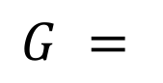
The Laplacian: Discrete Version
$$G =$$
$$a$$
$$b$$
$$c$$
$$d$$
$$e$$

Slide 43
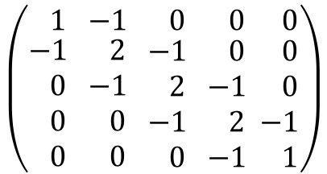
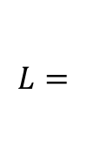
The Laplacian: Discrete Version
$$G =$$
$$a$$
$$b$$
$$c$$
$$d$$
$$e$$
The transformation $Δf=\frac{∂^{2}}{∂x^{2}}f{\left.​\right|}_{c}$ $≔f\left(b\right)−2f\left(c\right)+f(d)$is linear, so $Δ$can be described by a matrix:
$$\left(\begin{matrix} 1 \\ \begin{aligned}−1 \\ 0 \\ 0 \\ 0\end{aligned}\end{matrix} \begin{matrix}−1 \\ \begin{aligned} 2 \\ −1 \\ 0 \\ 0\end{aligned}\end{matrix} \begin{matrix} 0 \\ \begin{aligned}−1 \\ 2 \\ −1 \\ 0\end{aligned}\end{matrix}\begin{matrix} 0 \\ \begin{aligned} 0 \\ −1 \\ 2 \\ −1\end{aligned} \end{matrix}\begin{matrix} 0 \\ \begin{aligned} 0 \\ 0 \\ −1 \\ 1\end{aligned}\end{matrix}\right)$$
$$L=$$

Slide 44
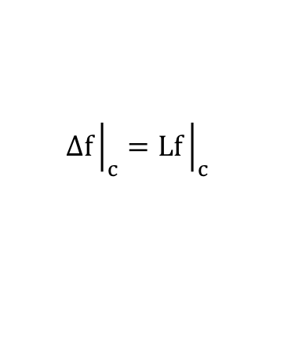
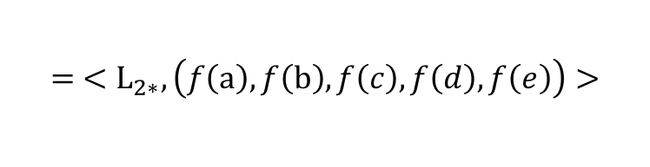
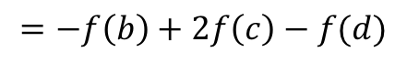
The Laplacian: Discrete Version
$$G =$$
$$a$$
$$b$$
$$c$$
$$d$$
$$e$$
The transformation $Δf=\frac{∂^{2}}{∂x^{2}}f{\left.​\right|}_{c}$ $≔f\left(b\right)−2f\left(c\right)+f(d)$is linear, so $Δ$can be described by a matrix:
$$\left(\begin{matrix} 1 \\ \begin{aligned}−1 \\ 0 \\ 0 \\ 0\end{aligned}\end{matrix} \begin{matrix}−1 \\ \begin{aligned} 2 \\ −1 \\ 0 \\ 0\end{aligned}\end{matrix} \begin{matrix} 0 \\ \begin{aligned}−1 \\ 2 \\ −1 \\ 0\end{aligned}\end{matrix}\begin{matrix} 0 \\ \begin{aligned} 0 \\ −1 \\ 2 \\ −1\end{aligned} \end{matrix}\begin{matrix} 0 \\ \begin{aligned} 0 \\ 0 \\ −1 \\ 1\end{aligned}\end{matrix}\right)$$
$$Δf{\left.​\right|}_{c}=Lf{\left.​\right|}_{c}$$
$$L=$$
$${= <L}_{2∗},\left(f\left(a\right),f\left(b\right),f\left(c\right),f\left(d\right), f\left(e\right)\right)>$$
$$=−f\left(b\right)+2f\left(c\right)−f(d)$$

Slide 45
The Laplacian: Discrete Version
$$G =$$
$$a$$
$$b$$
$$c$$
$$d$$
$$e$$
The transformation $Δf=\frac{∂^{2}}{∂x^{2}}f{\left.​\right|}_{c}$ $≔f\left(b\right)−2f\left(c\right)+f(d)$is linear, so $Δ$can be described by a matrix:
$$\left(\begin{matrix} 1 \\ \begin{aligned}−1 \\ 0 \\ 0 \\ 0\end{aligned}\end{matrix} \begin{matrix}−1 \\ \begin{aligned} 2 \\ −1 \\ 0 \\ 0\end{aligned}\end{matrix} \begin{matrix} 0 \\ \begin{aligned}−1 \\ 2 \\ −1 \\ 0\end{aligned}\end{matrix}\begin{matrix} 0 \\ \begin{aligned} 0 \\ −1 \\ 2 \\ −1\end{aligned} \end{matrix}\begin{matrix} 0 \\ \begin{aligned} 0 \\ 0 \\ −1 \\ 1\end{aligned}\end{matrix}\right)$$
$$Δf{\left.​\right|}_{c}=Lf{\left.​\right|}_{c}$$
$$L=$$
$${= <L}_{2∗},\left(f\left(a\right),f\left(b\right),f\left(c\right),f\left(d\right), f\left(e\right)\right)>$$
$$=−f\left(b\right)+2f\left(c\right)−f(d)$$
What if the structure of G varies from node to node?

Slide 46
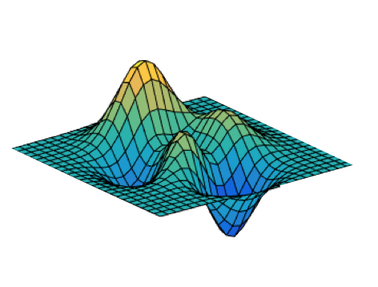
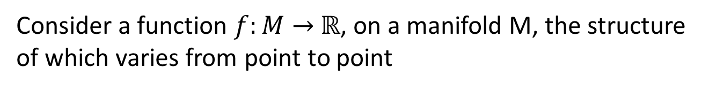
Laplacian on Curved Manifolds
Consider a function $f:M→$ $ℝ$, on a manifold M, the structure
of which varies from point to point
How should we define a notion of the Laplacian $∇_{M}$ when M has interesting structure?

Slide 47
Laplacian on Curved Manifolds
Riemannian Geometry
Def: A Riemannian manifold is a differentiable manifold endowed with a point-varying metric:

Slide 48
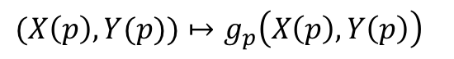
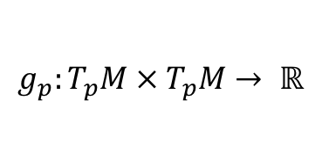
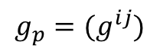
Laplacian on Curved Manifolds
Riemannian Geometry
Def: A Riemannian manifold is a differentiable manifold endowed with a point-varying metric:
$$g_{p}:T_{p}M × T_{p}M→ ℝ$$
$(X\left(p\right),Y(p))↦g_{p}\left(X\left(p\right),Y\left(p\right)\right)$
$$g_{p}=(g^{ij})$$

Slide 49
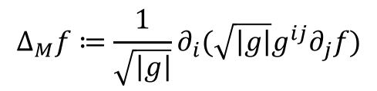
Laplacian on Curved Manifolds
Riemannian Geometry
Def: A Riemannian manifold is a differentiable manifold endowed with a point-varying metric:
$$g_{p}:T_{p}M × T_{p}M→ ℝ$$
$(X\left(p\right),Y(p))↦g_{p}\left(X\left(p\right),Y\left(p\right)\right)$
$$g_{p}=(g^{ij})$$
Laplacian:
$$Δ_{M}f≔\frac{1}{\sqrt{\left|g\right|}}∂_{i}(\sqrt{\left|g\right|}g^{ij}∂_{j}f)$$

Slide 50
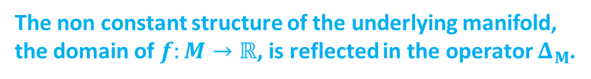
Laplacian on Curved Manifolds
Riemannian Geometry
Def: A Riemannian manifold is a differentiable manifold endowed with a point-varying metric:
$$g_{p}:T_{p}M × T_{p}M→ ℝ$$
$(X\left(p\right),Y(p))↦g_{p}\left(X\left(p\right),Y\left(p\right)\right)$
$$g_{p}=(g^{ij})$$
Laplacian:
$$Δ_{M}f≔\frac{1}{\sqrt{\left|g\right|}}∂_{i}(\sqrt{\left|g\right|}g^{ij}∂_{j}f)$$
The non constant structure of the underlying manifold,
the domain of $f:M→ℝ$, is reflected in the operator $Δ_{M}$.

Slide 51



Laplacian on Curved Manifolds
Riemannian Geometry
Def: A Riemannian manifold is a differentiable manifold endowed with a point-varying metric:
$$g_{p}:T_{p}M × T_{p}M→ ℝ$$
$(X\left(p\right),Y(p))↦g_{p}\left(X\left(p\right),Y\left(p\right)\right)$
$$g_{p}=(g^{ij})$$
Laplacian:
$$Δ_{M}f≔\frac{1}{\sqrt{\left|g\right|}}∂_{i}(\sqrt{\left|g\right|}g^{ij}∂_{j}f)$$
Euclidian Space Case:
$$g= \left(\begin{matrix}1 & ⋯ & 0 \\ ⋮ & ⋱ & ⋮ \\ 0 & ⋯ & 1\end{matrix}\right)$$
The non constant structure of the underlying manifold,
the domain of $f:M→ℝ$, is reflected in the operator $Δ_{M}$.
$g^{ij}=δ_{ij},$
This yields $Δf=∂_{i}^{2}f$ the standard Laplacian

Slide 52

Laplacian on Curved Manifolds
Riemannian Geometry
Def: A Riemannian manifold is a differentiable manifold endowed with a point-varying metric:
$$g_{p}:T_{p}M × T_{p}M→ ℝ$$
$(X\left(p\right),Y(p))↦g_{p}\left(X\left(p\right),Y\left(p\right)\right)$
$$g_{p}=(g^{ij})$$
Laplacian:
$$Δ_{M}f≔\frac{1}{\sqrt{\left|g\right|}}∂_{i}(\sqrt{\left|g\right|}g^{ij}∂_{j}f)$$
Euclidian Space Case:
$$g= \left(\begin{matrix}1 & ⋯ & 0 \\ ⋮ & ⋱ & ⋮ \\ 0 & ⋯ & 1\end{matrix}\right)$$
The non constant structure of the underlying manifold,
the domain of $f:M→ℝ$, is reflected in the operator $Δ_{M}$.
$g^{ij}=δ_{ij},$
The same is true in the graph case – the structure of the
underlying graph, the domain of $f:G→ℝ$, is reflected in
the operator $L.$
This yields $Δf=∂_{i}^{2}f$ the standard Laplacian

Slide 53


Laplacian on Nonlinear Graphs
General Definition
$$L_{ij}=\left\{\begin{aligned}\deg\left(v_{i}\right), if i=j \\ &−1, if v_{i}{ \sim v}_{j} \\ 0, otherwise\end{aligned}\right.$$
Note that $L=D−A,$

Slide 54

Laplacian on Nonlinear Graphs
General Definition
$$L_{ij}=\left\{\begin{aligned}\deg\left(v_{i}\right), if i=j \\ &−1, if v_{i}{ \sim v}_{j} \\ 0, otherwise\end{aligned}\right.$$
Note that $L=D−A,$
where D is the degree matrix
$$D=\left\{\begin{aligned}\deg\left(v_{i}\right), ifi=j \\ &0, otherwise\end{aligned}\right.$$

Slide 55

Laplacian on Nonlinear Graphs
General Definition
$$L_{ij}=\left\{\begin{aligned}\deg\left(v_{i}\right), if i=j \\ &−1, if v_{i}{ \sim v}_{j} \\ 0, otherwise\end{aligned}\right.$$
Note that $L=D−A,$
where D is the degree matrix
$$D=\left\{\begin{aligned}\deg\left(v_{i}\right), ifi=j \\ &0, otherwise\end{aligned}\right.$$
and A is the adjacency matrix
$$A=\left\{\begin{aligned}1, v_{i} \sim v_{j} \\ &0, otherwise\end{aligned}\right.$$

Slide 56


Laplacian on Nonlinear Graphs
General Definition
$$L_{ij}=\left\{\begin{aligned}\deg\left(v_{i}\right), if i=j \\ &−1, if v_{i}{ \sim v}_{j} \\ 0, otherwise\end{aligned}\right.$$
$$L$$
1 -1 0 0 0 0 0 0
-1 4 -1 -1 0 0 -1 0
0 -1 4 0 -1 -1 -1 0
0 -1 0 4 -1 -1 -1 0
0 0 -1 -1 3 0 -1 0
0 0 -1 -1 0 3 -1 0
0 -1 -1 -1 -1 -1 6 -1
0 0 0 0 0 0 -1 1
Note that $L=D−A,$
where D is the degree matrix
$$D=\left\{\begin{aligned}\deg\left(v_{i}\right), ifi=j \\ &0, otherwise\end{aligned}\right.$$
and A is the adjacency matrix
$$A=\left\{\begin{aligned}1, v_{i} \sim v_{j} \\ &0, otherwise\end{aligned}\right.$$

Slide 57

Laplacian on Nonlinear Graphs
General Definition
$$L_{ij}=\left\{\begin{aligned}\deg\left(v_{i}\right), if i=j \\ &−1, if v_{i}{ \sim v}_{j} \\ 0, otherwise\end{aligned}\right.$$
$$L$$
1 -1 0 0 0 0 0 0
-1 4 -1 -1 0 0 -1 0
0 -1 4 0 -1 -1 -1 0
0 -1 0 4 -1 -1 -1 0
0 0 -1 -1 3 0 -1 0
0 0 -1 -1 0 3 -1 0
0 -1 -1 -1 -1 -1 6 -1
0 0 0 0 0 0 -1 1
Note that $L=D−A,$
where D is the degree matrix
$$D=\left\{\begin{aligned}\deg\left(v_{i}\right), ifi=j \\ &0, otherwise\end{aligned}\right.$$
and A is the adjacency matrix
The structure of the graph changes from node to node, and is reflected in the non-constant block diagonal structure of $L$.
$$A=\left\{\begin{aligned}1, v_{i} \sim v_{j} \\ &0, otherwise\end{aligned}\right.$$

Slide 58

Wave Equation on Graphs
Recall the wave equation $Δu=\frac{∂^{2}u}{∂t^{2}}.$

Slide 59

Wave Equation on Graphs
Recall the wave equation $Δu=\frac{∂^{2}u}{∂t^{2}}.$
Let $u\left(x,t\right)$ be a function $u:Vert\left(G\right) × ℝ→ℝ,$ which is a solution to $\frac{∂^{2}u}{∂t^{2}}=Lu.$

Slide 60

Wave Equation on Graphs
Recall the wave equation $Δu=\frac{∂^{2}u}{∂t^{2}}.$
Let $u\left(x,t\right)$ be a function $u:Vert\left(G\right) × ℝ→ℝ,$ which is a solution to $\frac{∂^{2}u}{∂t^{2}}=Lu.$
Then $u$ has the form $u\left(x,t\right)=e^{\sqrt{λ_{i}}t}v_{i}\left(x\right),$ where $v_{i}$ is an eigenvector with corresponding
eigenvalue $λ_{i}.$

Slide 61

Wave Equation on Graphs
Recall the wave equation $Δu=\frac{∂^{2}u}{∂t^{2}}.$
Let $u\left(x,t\right)$ be a function $u:Vert\left(G\right) × ℝ→ℝ,$ which is a solution to $\frac{∂^{2}u}{∂t^{2}}=Lu.$
Then $u$ has the form $u\left(x,t\right)=e^{\sqrt{λ_{i}}t}v_{i}\left(x\right),$ where $v_{i}$ is an eigenvector with corresponding
eigenvalue $λ_{i}.$
Upshot: The eigenvalues of $L$, which correspond to the vibrational frequencies of the wave solutions
on $G$, are determined by the structure of $G$.

Slide 62
Wave Equation on Graphs
Recall the wave equation $Δu=\frac{∂^{2}u}{∂t^{2}}.$
Let $u\left(x,t\right)$ be a function $u:Vert\left(G\right) × ℝ→ℝ,$ which is a solution to $\frac{∂^{2}u}{∂t^{2}}=Lu.$
Then $u$ has the form $u\left(x,t\right)=e^{\sqrt{λ_{i}}t}v_{i}\left(x\right),$ where $v_{i}$ is an eigenvector with corresponding
eigenvalue $λ_{i}.$
Upshot: The eigenvalues of $L$, which correspond to the vibrational frequencies of the wave solutions
on $G$, are determined by the structure of $G$.
Spectral Graph Theory: the study of graph structure via the spectra of various graph-associated matrices.

Slide 63
Wave Equation on Graphs
Recall the wave equation $Δu=\frac{∂^{2}u}{∂t^{2}}.$
Let $u\left(x,t\right)$ be a function $u:Vert\left(G\right) × ℝ→ℝ,$ which is a solution to $\frac{∂^{2}u}{∂t^{2}}=Lu.$
Then $u$ has the form $u\left(x,t\right)=e^{\sqrt{λ_{i}}t}v_{i}\left(x\right),$ where $v_{i}$ is an eigenvector with corresponding
eigenvalue $λ_{i}.$
Upshot: The eigenvalues of $L$, which correspond to the vibrational frequencies of the wave solutions
on $G$, are determined by the structure of $G$.
Spectral Graph Theory: the study of graph structure via the spectra of various graph-associated matrices.
We can exploit the correspondence between frequency and wavelength to visualize graph spectra:

Slide 64
Laplacian Spectra - Eigenvalues
Eigenvalues correspond to frequencies of wave solutions on the domain – can render as wavelengths

Slide 65

Laplacian Spectra - Eigenvalues
Eigenvalues correspond to frequencies of wave solutions on the domain – can render as wavelengths
Consider the
Laplacian matrix L
and its associated
eigenvectors and
eigenvalues. We
compute the
spectrum
$Λ = \{λ_{1},…,λ_{|G|}\}$,
and apply the
transformation
$$λ↦400+300\frac{|λ|}{|G|}$$

Slide 66

Laplacian Spectra - Eigenvalues
Eigenvalues correspond to frequencies of wave solutions on the domain – can render as wavelengths
Consider the
Laplacian matrix L
and its associated
eigenvectors and
eigenvalues. We
compute the
spectrum
$Λ = \{λ_{1},…,λ_{|G|}\}$,
and apply the
transformation
$$λ↦400+300\frac{|λ|}{|G|}$$

Slide 67

Laplacian Spectra - Eigenvalues
Eigenvalues correspond to frequencies of wave solutions on the domain – can render as wavelengths
Consider the
Laplacian matrix L
and its associated
eigenvectors and
eigenvalues. We
compute the
spectrum
$Λ = \{λ_{1},…,λ_{|G|}\}$,
and apply the
transformation
$$λ↦400+300\frac{|λ|}{|G|}$$

Slide 68

Laplacian Spectra - Eigenvalues
Eigenvalues correspond to frequencies of wave solutions on the domain – can render as wavelengths
Consider the
Laplacian matrix L
and its associated
eigenvectors and
eigenvalues. We
compute the
spectrum
$Λ = \{λ_{1},…,λ_{|G|}\}$,
and apply the
transformation
$$λ↦400+300\frac{|λ|}{|G|}$$

Slide 69

Laplacian Spectra - Eigenvalues
Eigenvalues correspond to frequencies of wave solutions on the domain – can render as wavelengths
Consider the
Laplacian matrix L
and its associated
eigenvectors and
eigenvalues. We
compute the
spectrum
$Λ = \{λ_{1},…,λ_{|G|}\}$,
and apply the
transformation
$$λ↦400+300\frac{|λ|}{|G|}$$

Slide 70

Curvature – Higher Dimensions
The Laplacian
Define $Δ=\frac{∂^{2}}{∂x_{1}^{2}}+\frac{∂^{2}}{∂x_{2}^{2}}+⋯+\frac{∂^{2}}{∂x_{n}^{2}}$
Application: The Heat Equation
$\frac{∂u}{∂t}=Δu$
Question 1: What do the solutions to this PDE look like?
Question 2: Is it possible to infer manifold structure from the structure of the operator?
Question 3: Is it possible to answer Question 2 in the graph case?

Slide 71
Heat Kernels on Graphs
How can we measure the similarity between nodes in a graph using
heat diffusion?

Slide 72
Heat Kernels on Graphs
How can we measure the similarity between nodes in a graph using
heat diffusion?
Consider the following process defined on the node set $Vert\left(G\right)=\left\{1,2,…,\left|Vert\left(G\right)\right|\right\}:$

Slide 73


Heat Kernels on Graphs
How can we measure the similarity between nodes in a graph using
heat diffusion?
Consider the following process defined on the node set $Vert\left(G\right)=\left\{1,2,…,\left|Vert\left(G\right)\right|\right\}:$
$Z\left(t\right)={\left(Z_{1}\left(t\right),Z_{2}\left(t\right), …, Z_{\left|V\right|}\left(t\right)\right)}^{T}$, where
$$Z_{i}\left(t+1\right)=Z_{i}\left(t\right)+α\sum_{j∈V:j \sim i}{\left(Z_{j}\left(t\right)−Z_{i}\left(t\right)\right)}$$

Slide 74

Heat Kernels on Graphs
How can we measure the similarity between nodes in a graph using
heat diffusion?
Consider the following process defined on the node set $Vert\left(G\right)=\left\{1,2,…,\left|Vert\left(G\right)\right|\right\}:$
$Z\left(t\right)={\left(Z_{1}\left(t\right),Z_{2}\left(t\right), …, Z_{\left|V\right|}\left(t\right)\right)}^{T}$, where
$$Z_{i}\left(t+1\right)=Z_{i}\left(t\right)+α\sum_{j∈V:j \sim i}{\left(Z_{j}\left(t\right)−Z_{i}\left(t\right)\right)}$$
Intuition: Each node borrows a percentage $α$of heat from its neighbors based on the
pairwise heat differential.

Slide 75

Heat Kernels on Graphs
How can we measure the similarity between nodes in a graph using
heat diffusion?
Consider the following process defined on the node set $Vert\left(G\right)=\left\{1,2,…,\left|Vert\left(G\right)\right|\right\}:$
$Z\left(t\right)={\left(Z_{1}\left(t\right),Z_{2}\left(t\right), …, Z_{\left|V\right|}\left(t\right)\right)}^{T}$, where
$$Z_{i}\left(t+1\right)=Z_{i}\left(t\right)+α\sum_{j∈V:j \sim i}{\left(Z_{j}\left(t\right)−Z_{i}\left(t\right)\right)}$$
Intuition: Each node borrows a percentage $α$of heat from its neighbors based on the
pairwise heat differential.
Notice that each node $i$ is counted $deg⁡(i)$ times in this sum.

Slide 76



Heat Kernels on Graphs
How can we measure the similarity between nodes in a graph using
heat diffusion?
Consider the following process defined on the node set $Vert\left(G\right)=\left\{1,2,…,\left|Vert\left(G\right)\right|\right\}:$
$Z\left(t\right)={\left(Z_{1}\left(t\right),Z_{2}\left(t\right), …, Z_{\left|V\right|}\left(t\right)\right)}^{T}$, where
$$Z_{i}\left(t+1\right)=Z_{i}\left(t\right)+α\sum_{j∈V:j \sim i}{\left(Z_{j}\left(t\right)−Z_{i}\left(t\right)\right)}$$
Intuition: Each node borrows a percentage $α$of heat from its neighbors based on the
pairwise heat differential.
Notice that each node $i$ is counted $deg⁡(i)$ times in this sum.
We can therefore describe $Z(t)$ for $t∈ ℕ$ as
$Z\left(t\right)=T\left(t\right)Z(0)$
where $T\left(t\right)={\left(1−αL\right)}^{t}$ for $L$ the Laplacian.

Slide 77



Heat Kernels
$$Z_{i}\left(t+1\right)=Z_{i}\left(t\right)+α\sum_{j∈V:j \sim i}{\left(Z_{j}\left(t\right)−Z_{i}\left(t\right)\right)}$$
$Z\left(t\right)=T\left(t\right)Z\left(0\right)={\left(1−αL\right)}^{t}Z(0)$
What happens to $Z\left(t\right)=T\left(t\right)Z\left(0\right)$ as $t→∞$ ?

Slide 78


Heat Kernels
$$Z_{i}\left(t+1\right)=Z_{i}\left(t\right)+α\sum_{j∈V:j \sim i}{\left(Z_{j}\left(t\right)−Z_{i}\left(t\right)\right)}$$
$Z\left(t\right)=T\left(t\right)Z\left(0\right)={\left(1−αL\right)}^{t}Z(0)$
What happens to $Z\left(t\right)=T\left(t\right)Z\left(0\right)$ as $t→∞$ ?
$T\left(t\right)={\left(1+ \frac{αH}{\frac{1}{Δt}}\right)}^{\frac{t}{Δt}}$ and let $Δt→0$
Rewrite $T\left(t\right)={\left(1−αL\right)}^{t}$ as

Slide 79
Heat Kernels
$$Z_{i}\left(t+1\right)=Z_{i}\left(t\right)+α\sum_{j∈V:j \sim i}{\left(Z_{j}\left(t\right)−Z_{i}\left(t\right)\right)}$$
$Z\left(t\right)=T\left(t\right)Z\left(0\right)={\left(1−αL\right)}^{t}Z(0)$
What happens to $Z\left(t\right)=T\left(t\right)Z\left(0\right)$ as $t→∞$ ?
$T\left(t\right)={\left(1+ \frac{αH}{\frac{1}{Δt}}\right)}^{\frac{t}{Δt}}$ and let $Δt→0$
Rewrite $T\left(t\right)={\left(1−αL\right)}^{t}$ as
This yields the kernel $K_{−2αt}≔σ^{2}e^{−2αtL}$. Ignoring $σ$ and setting $β≔−2αt$, we can rewrite $K_{β}$ as $e^{βL},$

Slide 80


Heat Kernels
$$Z_{i}\left(t+1\right)=Z_{i}\left(t\right)+α\sum_{j∈V:j \sim i}{\left(Z_{j}\left(t\right)−Z_{i}\left(t\right)\right)}$$
$Z\left(t\right)=T\left(t\right)Z\left(0\right)={\left(1−αL\right)}^{t}Z(0)$
What happens to $Z\left(t\right)=T\left(t\right)Z\left(0\right)$ as $t→∞$ ?
$T\left(t\right)={\left(1+ \frac{αH}{\frac{1}{Δt}}\right)}^{\frac{t}{Δt}}$ and let $Δt→0$
Rewrite $T\left(t\right)={\left(1−αL\right)}^{t}$ as
This yields the kernel $K_{−2αt}≔σ^{2}e^{−2αtL}$. Ignoring $σ$ and setting $β≔−2αt$, we can rewrite $K_{β}$ as $e^{βL},$
where for any matrix $H,$
$$e^{βH}=\lim_{n→∞}{{\left(1+\frac{βH}{n}\right)}^{n}=I+βH+\frac{1}{2!}{βH}^{2}+\frac{1}{3!}{βH}^{3}+⋯}$$

Slide 81
Heat Kernels
$$Z_{i}\left(t+1\right)=Z_{i}\left(t\right)+α\sum_{j∈V:j \sim i}{\left(Z_{j}\left(t\right)−Z_{i}\left(t\right)\right)}$$
$Z\left(t\right)=T\left(t\right)Z\left(0\right)={\left(1−αL\right)}^{t}Z(0)$
What happens to $Z\left(t\right)=T\left(t\right)Z\left(0\right)$ as $t→∞$ ?
$T\left(t\right)={\left(1+ \frac{αH}{\frac{1}{Δt}}\right)}^{\frac{t}{Δt}}$ and let $Δt→0$
Rewrite $T\left(t\right)={\left(1−αL\right)}^{t}$ as
This yields the kernel $K_{−2αt}≔σ^{2}e^{−2αtL}$. Ignoring $σ$ and setting $β≔−2αt$, we can rewrite $K_{β}$ as $e^{βL},$
where for any matrix $H,$
$$e^{βH}=\lim_{n→∞}{{\left(1+\frac{βH}{n}\right)}^{n}=I+βH+\frac{1}{2!}{βH}^{2}+\frac{1}{3!}{βH}^{3}+⋯}$$
Notice $K_{β}$ satisfies $\frac{d}{dβ}K_{β}=LK_{β}$. This is precisely the heat equation on $G$.

Slide 82
Heat (Dense and Sparse)
Example: We consider two graphs
with the same node set, but with
different edge structure. The goal
is to test if it is possible, through
heat diffusion, to measure differences
in node similarity

Slide 83
Heat (Dense and Sparse)
Example: We consider two graphs
with the same node set, but with
different edge structure. The goal
is to test if it is possible, through
heat diffusion, to measure differences
in node similarity
Dense

Slide 84

Heat (Dense and Sparse)
Example: We consider two graphs
with the same node set, but with
different edge structure. The goal
is to test if it is possible, through
heat diffusion, to measure differences
in node similarity
Dense
Sparse

Slide 85
Heat (Dense and Sparse)
Example: We consider two graphs
with the same node set, but with
different edge structure. The goal
is to test if it is possible, through
heat diffusion, to measure differences
in node similarity
Dense
Sparse
Step 1: Heat node 0

Slide 86
Heat (Dense and Sparse)
Example: We consider two graphs
with the same node set, but with
different edge structure. The goal
is to test if it is possible, through
heat diffusion, to measure differences
in node similarity
Dense
Sparse
Step 1: Heat node 0
Step 2: Observe heat in each node
as it diffuses through the graph

Slide 87

Heat (Dense and Sparse)
Example: We consider two graphs
with the same node set, but with
different edge structure. The goal
is to test if it is possible, through
heat diffusion, to measure differences
in node similarity
Dense
Sparse
Step 1: Heat node 0
Step 2: Observe heat in each node
as it diffuses through the graph
Step 3: Compute node similarity
based on node to node heat transfer
between times $0$ and $∞$

Slide 88



Heat (Dense vs Sparse)
Dense
Sparse
Hot
Cold

Slide 89


Heat (Dense vs Sparse)
Dense
Sparse

Slide 90



Heat Kernels - Vectorization
Vectorize each graph via Cholesky factorization of $K_{β}=F^{T}F$. Vectors correspond to columns of $F.$

Slide 91
Transfer Kernels
Once we have intuition, we can build our own kernels via perturbations of known kernels.
Alter process by considering a directed graph version of the above example, and only allow
heat transfer along directed edges.

Slide 92



Transfer Kernels
Once we have intuition, we can build our own kernels via perturbations of known kernels.
Alter process by considering a directed graph version of the above example, and only allow
heat transfer along directed edges.
Original heat kernel process: Undirected graph $G$ with $V≔Vert\left(G\right).$
$Z\left(t\right)={\left(Z_{1}\left(t\right),Z_{2}\left(t\right), …, Z_{\left|V\right|}\left(t\right)\right)}^{T}$, where
$Z\left(t\right)=T\left(t\right)Z(0)$
$$Z_{i}\left(t+1\right)=Z_{i}\left(t\right)+α\sum_{j∈V:j \sim i}{\left(Z_{j}\left(t\right)−Z_{i}\left(t\right)\right)}$$
where $T\left(t\right)={\left(1−αL\right)}^{t}$ for $L$ the Laplacian.
Note that $L=D−A,$

Slide 93
Transfer Kernels
Once we have intuition, we can build our own kernels via perturbations of known kernels.
Alter process by considering a directed graph version of the above example, and only allow
heat transfer along directed edges.
Original heat kernel process: Undirected graph $G$ with $V≔Vert\left(G\right).$
$Z\left(t\right)={\left(Z_{1}\left(t\right),Z_{2}\left(t\right), …, Z_{\left|V\right|}\left(t\right)\right)}^{T}$, where
$Z\left(t\right)=T\left(t\right)Z(0)$
$$Z_{i}\left(t+1\right)=Z_{i}\left(t\right)+α\sum_{j∈V:j \sim i}{\left(Z_{j}\left(t\right)−Z_{i}\left(t\right)\right)}$$
where $T\left(t\right)={\left(1−αL\right)}^{t}$ for $L$ the Laplacian.
Note that $L=D−A,$
New heat kernel process: Directed graph $G$ with $V≔Vert\left(G\right).$

Slide 94

Transfer Kernels
Once we have intuition, we can build our own kernels via perturbations of known kernels.
Alter process by considering a directed graph version of the above example, and only allow
heat transfer along directed edges.
Original heat kernel process: Undirected graph $G$ with $V≔Vert\left(G\right).$
$Z\left(t\right)={\left(Z_{1}\left(t\right),Z_{2}\left(t\right), …, Z_{\left|V\right|}\left(t\right)\right)}^{T}$, where
$Z\left(t\right)=T\left(t\right)Z(0)$
$$Z_{i}\left(t+1\right)=Z_{i}\left(t\right)+α\sum_{j∈V:j \sim i}{\left(Z_{j}\left(t\right)−Z_{i}\left(t\right)\right)}$$
where $T\left(t\right)={\left(1−αL\right)}^{t}$ for $L$ the Laplacian.
Note that $L=D−A,$
New heat kernel process: Directed graph $G$ with $V≔Vert\left(G\right).$
$Z\left(t\right)={\left(Z_{1}\left(t\right),Z_{2}\left(t\right), …, Z_{\left|V\right|}\left(t\right)\right)}^{T}$, where
$$Z_{i}\left(t+1\right)=Z_{i}\left(t\right)+α\sum_{j∈V:i→j}{\left(Z_{j}\left(t\right)−Z_{i}\left(t\right)\right)}$$

Slide 95



Transfer Kernels
Once we have intuition, we can build our own kernels via perturbations of known kernels.
Alter process by considering a directed graph version of the above example, and only allow
heat transfer along directed edges.
Original heat kernel process: Undirected graph $G$ with $V≔Vert\left(G\right).$
$Z\left(t\right)={\left(Z_{1}\left(t\right),Z_{2}\left(t\right), …, Z_{\left|V\right|}\left(t\right)\right)}^{T}$, where
$Z\left(t\right)=T\left(t\right)Z(0)$
$$Z_{i}\left(t+1\right)=Z_{i}\left(t\right)+α\sum_{j∈V:j \sim i}{\left(Z_{j}\left(t\right)−Z_{i}\left(t\right)\right)}$$
where $T\left(t\right)={\left(1−αL\right)}^{t}$ for $L$ the Laplacian.
Note that $L=D−A,$
New heat kernel process: Directed graph $G$ with $V≔Vert\left(G\right).$
$Z\left(t\right)={\left(Z_{1}\left(t\right),Z_{2}\left(t\right), …, Z_{\left|V\right|}\left(t\right)\right)}^{T}$, where
$Z\left(t\right)=T\left(t\right)Z(0)$
$$Z_{i}\left(t+1\right)=Z_{i}\left(t\right)+α\sum_{j∈V:i→j}{\left(Z_{j}\left(t\right)−Z_{i}\left(t\right)\right)}$$
where $T\left(t\right)={\left(1−αL_{O}\right)}^{t}$ for $L$ the Laplacian.
Note that $L_{O}=D_{out}−A,$

Slide 96


Transfer (Dense vs Sparse)
Dense
Sparse
Hot
Cold

Slide 97


Transfer (Dense and Sparse)
Dense
Sparse

Slide 98

Heat Kernels - Applications
Assume we have a kernel $K$ defined on some set $Ω$, that is, we have a map $K:Ω × Ω→ ℝ$

Slide 99

Heat Kernels - Applications
Assume we have a kernel $K$ defined on some set $Ω$, that is, we have a map $K:Ω × Ω→ ℝ$
Question: How can we define a kernel on $Ω^{n}≔Ω × ⋯ × Ω$ ?

Slide 100

Heat Kernels - Applications
Assume we have a kernel $K$ defined on some set $Ω$, that is, we have a map $K:Ω × Ω→ ℝ$
Question: How can we define a kernel on $Ω^{n}≔Ω × ⋯ × Ω$ ?
Answer: Construct the tensor product $K^{n}≔⊗_{i=1}^{n}K$ defined by $K^{n}\left(x,x^{′}\right)=\prod_{i=1}^{n}{K(x_{i},x_{i}^{′})}$

Slide 101





Heat Kernels - Applications
Assume we have a kernel $K$ defined on some set $Ω$, that is, we have a map $K:Ω × Ω→ ℝ$
Question: How can we define a kernel on $Ω^{n}≔Ω × ⋯ × Ω$ ?
Answer: Construct the tensor product $K^{n}≔⊗_{i=1}^{n}K$ defined by $K^{n}\left(x,x^{′}\right)=\prod_{i=1}^{n}{K(x_{i},x_{i}^{′})}$
Example: Construct kernel on binary strings via the construction of a graph kernel on the hypercube
$$\{\left(0,0,1\right),(1,1,0)\}$$
$$d\left(\left(0,0,1\right),\left(1,1,0\right)\right)=3$$
$$\{\left(1,0,0\right),(1,1,1)\}$$
$$d\left(\left(1,0,0\right),\left(1,1,1\right)\right)=2$$
Idea is to measure similarity between points $(0,0,1)$and $(1,1,0),$and
between points $(1,0,0)$and $\left(1,1,1\right),$ while taking into account the
graph structure.

Slide 102

Heat Kernels - Applications
$$\{\left(0,0,1\right),(1,1,0)\}$$
$$d\left(\left(0,0,1\right),\left(1,1,0\right)\right)=3$$
$$\{\left(1,0,0\right),(1,1,1)\}$$
$$d\left(\left(1,0,0\right),\left(1,1,1\right)\right)=2$$
Idea is to measure similarity between points $(0,0,1)$and $(1,1,0),$and
between points $(1,0,0)$and $\left(1,1,1\right),$ while taking into account the
graph structure.

Slide 103










Heat Kernels - Applications
$$\{\left(0,0,1\right),(1,1,0)\}$$
$$d\left(\left(0,0,1\right),\left(1,1,0\right)\right)=3$$
$$\{\left(1,0,0\right),(1,1,1)\}$$
$$d\left(\left(1,0,0\right),\left(1,1,1\right)\right)=2$$
Idea is to measure similarity between points $(0,0,1)$and $(1,1,0),$and
between points $(1,0,0)$and $\left(1,1,1\right),$ while taking into account the
graph structure.
The hypercube can be constructed
by successive cross products of
simpler graphs.
$$1$$
$$1$$
$$1$$
$$≅$$
$$×$$
$$×$$
$L_{ij}=−1+δ_{ij}n$ for an unweighted
complete graph.
$$0$$
$$0$$
$$0$$

Slide 104










Heat Kernels - Applications
The hypercube can be constructed
by successive cross products of
simpler graphs.
$$1$$
$$1$$
$$1$$
$$≅$$
$$×$$
$$×$$
$L_{ij}=−1+δ_{ij}n$ for an unweighted
complete graph.
$$0$$
$$0$$
$$0$$

Slide 105

Heat Kernels - Applications
The hypercube can be constructed
by successive cross products of
simpler graphs.
$$1$$
$$1$$
$$1$$
$$≅$$
$$×$$
$$×$$
$L_{ij}=−1+δ_{ij}n$ for an unweighted
complete graph.
$$0$$
$$0$$
$$0$$
Solving $\frac{d}{dβ}K_{β}=LK_{β}$ on the complete graph with $n$ vertices yields
$$K\left(i,j\right)=\left\{\begin{aligned}\frac{1+\left(n−1\right)e^{−nβ}}{n}, for i=j \\ &\frac{1−e^{−nβ}}{n}, for i≠j\end{aligned}\right.$$

Slide 106



Heat Kernels - Applications
The hypercube can be constructed
by successive cross products of
simpler graphs.
$$1$$
$$1$$
$$1$$
$$≅$$
$$×$$
$$×$$
$L_{ij}=−1+δ_{ij}n$ for an unweighted
complete graph.
$$0$$
$$0$$
$$0$$
Solving $\frac{d}{dβ}K_{β}=LK_{β}$ on the complete graph with $n$ vertices yields
$$K\left(i,j\right)=\left\{\begin{aligned}\frac{1+\left(n−1\right)e^{−nβ}}{n}, for i=j \\ &\frac{1−e^{−nβ}}{n}, for i≠j\end{aligned}\right.$$
$$K\left(x,x^{′}\right)∝ {\left(\frac{1−e^{−2β}}{1+e^{−2β}}\right)}^{d\left(x,x^{′}\right)}$$
and applying $K^{n}\left(x,x^{′}\right)=\prod_{i=1}^{n}{K(x_{i},x_{i}^{′})}$ gives the kernel
$$=({\tanh{β)}}^{d\left(x,x^{′}\right)}$$

Slide 107




Heat Kernels - Applications
The hypercube can be constructed
by successive cross products of
simpler graphs.
$$1$$
$$1$$
$$1$$
$$≅$$
$$×$$
$$×$$
$L_{ij}=−1+δ_{ij}n$ for an unweighted
complete graph.
$$0$$
$$0$$
$$0$$
Solving $\frac{d}{dβ}K_{β}=LK_{β}$ on the complete graph with $n$ vertices yields
$$K\left(i,j\right)=\left\{\begin{aligned}\frac{1+\left(n−1\right)e^{−nβ}}{n}, for i=j \\ &\frac{1−e^{−nβ}}{n}, for i≠j\end{aligned}\right.$$
$$K\left(x,x^{′}\right)∝ {\left(\frac{1−e^{−2β}}{1+e^{−2β}}\right)}^{d\left(x,x^{′}\right)}$$
and applying $K^{n}\left(x,x^{′}\right)=\prod_{i=1}^{n}{K(x_{i},x_{i}^{′})}$ gives the kernel
$K($ , $)$
$${=tanh\left(0.1\right)}^{3} = 0.00099$$
$$=({\tanh{β)}}^{d\left(x,x^{′}\right)}$$
$K($ , $)$
$${=tanh\left(0.1\right)}^{2} = 0.00993$$

Slide 108
Thank you!
The End

Slide 109







Inter Graph Diffusion Kernels
Tensor Product of Graphs
$$G_{×}≔G⊗G^{′}$$
$$V_{×}=\{\left(v_{i},v_{r}^{′}\right):v_{i}∈V, v_{r}^{′}∈V^{′}\}$$
$$E_{×}=\left\{\left(\left(v_{i},v_{r}^{′}\right),\left(v_{j},v_{s}^{′}\right)\right):\left(v_{i},v_{j}\right)∈E∧\left(v_{r}^{′},v_{s}^{′}\right)∈E^{′}\right\}$$
$$=$$
$$⊗$$

Slide 110
Inter Graph Diffusion Kernels
Construction of Kernel between edge-labeled graphs

Slide 111
Inter Graph Diffusion Kernels
Dotnet function to function graphs – example of kernel between these graphs
Plot TSNE vectorization using edge-labeled kernel

Slide 112
Inter Graph Diffusion Kernels
Functions defined on the set of vertices

Slide 113
Inter Graph Diffusion Kernels
Lebesgue integral of functions on vertex set

Slide 114
Inter Graph Diffusion Kernels
Use this vectorization and TNSE or LargeViz to plot a bunch of dotnet function to function graphs
Good vs Bad red and blue scatter plot

Slide 115


Inter Graph Diffusion Kernels
Kronecker Product: Let M and N be matrices. Then
$$A⊗B= \left[\begin{matrix}a_{11}B & ⋯ & a_{1n}B \\ ⋮ & ⋱ & ⋮ \\ a_{m1}B & ⋯ & a_{mn}B\end{matrix}\right]$$
$$\left[\begin{matrix}1 & 2 \\ 3 & 4\end{matrix}\right]⊗\left[\begin{matrix}0 & 5 \\ 6 & 7\end{matrix}\right]=\left[\begin{matrix}1⋅\left[\begin{matrix}0 & 5 \\ 6 & 7\end{matrix}\right] & 2⋅\left[\begin{matrix}0 & 5 \\ 6 & 7\end{matrix}\right] \\ 3⋅\left[\begin{matrix}0 & 5 \\ 6 & 7\end{matrix}\right] & 4⋅\left[\begin{matrix}0 & 5 \\ 6 & 7\end{matrix}\right]\end{matrix}\right]=\left[\begin{matrix}0 \\ \begin{aligned}6 \\ 0 \\ 18\end{aligned}\end{matrix}\begin{matrix}5 \\ \begin{aligned}7 \\ 15 \\ 21\end{aligned}\end{matrix}\begin{matrix}0 \\ \begin{aligned}12 \\ 0 \\ 24\end{aligned}\end{matrix}\begin{matrix}10 \\ \begin{aligned}14 \\ 20 \\ 28\end{aligned}\end{matrix}\right]$$

Slide 116



Inter Graph Diffusion Kernels
Describe how a heat kernel can serve to measure similarity
Derivation of Heat Kernels
String Kernel
Vectorization
$$A⨂B$$
$$Φ\left(X\right)A⨂B Φ\left(X^{′}\right)$$
$$k\left(G,G^{′}\right)≔\sum_{k=0}^{∞}{μ\left(k\right)q_{×}^{T}W_{×}^{k}p_{×}}$$

Slide 117




Inter Graph Diffusion Kernels
Picture with graph of results
Application to clusters within graph
$$k\left(G,G^{′}\right)≔\sum_{k=0}^{∞}{q_{×}^{T}{\left(P_{×}D_{×}P_{×}^{−1}\right)}^{k}p_{×}}$$
$$q_{×}^{T}P_{×}\left(\sum_{k=0}^{∞}{μ\left(k\right)D_{×}^{k}) }\right)P_{×}^{−1}p_{× }$$
$$k\left(G,G^{′}\right)≔q_{×}^{T}P_{×}e^{λD_{×}}P_{×}^{−1}p_{×}$$
$$k\left(G,G^{′}\right)≔q_{×}^{T}P_{×}{\left(Ι−λD_{×}\right)}^{−1}P_{×}^{−1}p_{×}$$

Slide 118
References
Chung, F.
More…

